Slide 1
Centrality in networks
Degree Centrality and Eigenvector Centrality

Slide 2
Degree Centrality

Slide 3
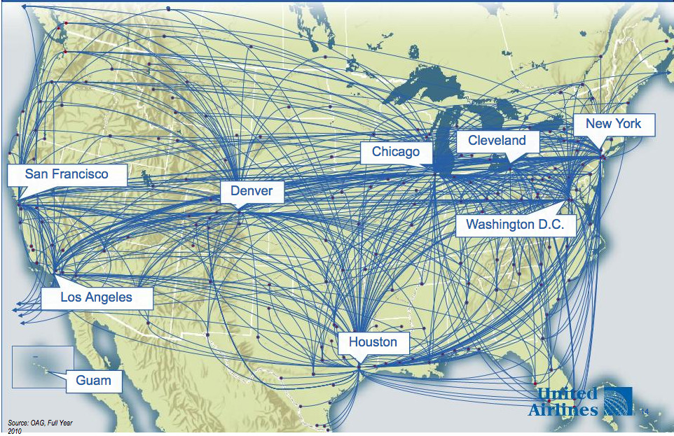
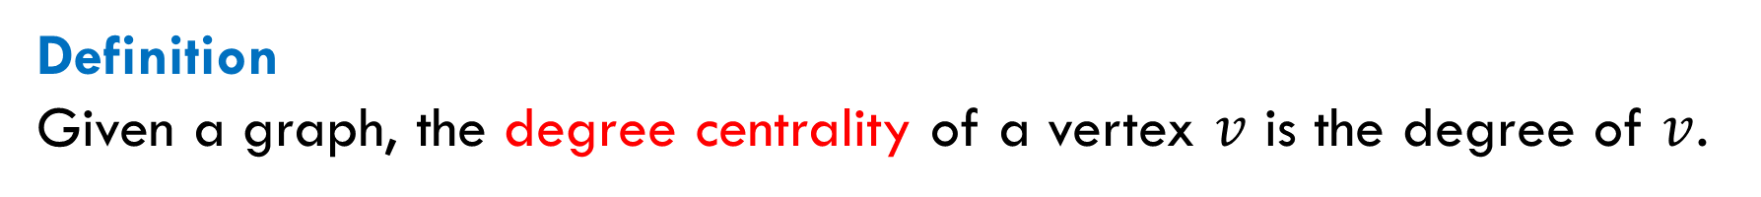
Simple Measure of Centrality
Definition
Given a graph, the degree centrality of a vertex $v$ is the degree of $v$.
Example
Hubs of United Airlines

Slide 4

Another Example: Social Hubs
Individuals who have many friends or acquaintances might have more influence, more access to information, or more prestige than those who have fewer.
Drawback
Not all neighbors are equivalent. For instance, a node might have only few friends, but if those friends are, say, Nobel laureates, the node may be an important individual.

Slide 5
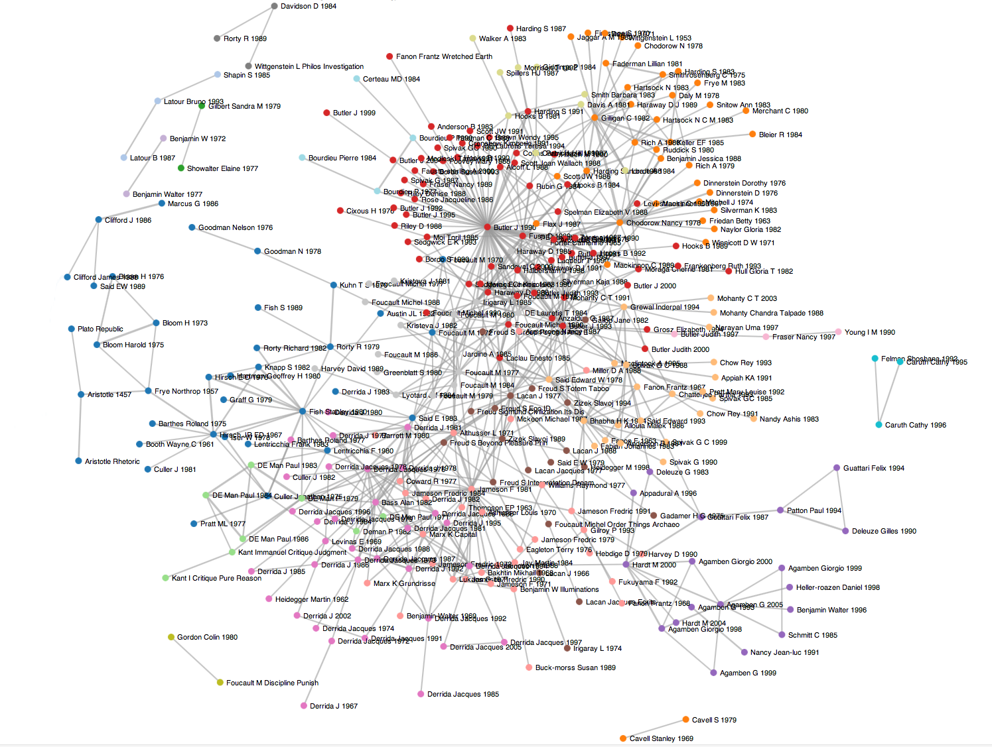

Directed Graphs: In-Degree Centrality
Definition. Given a directed graph, the in-degree centrality of a vertex $v$ is the in-degree of $v$.
Example: Citation Networks. The number of references to an article shows how influential this article. This measure and its variants are widely used.
Drawback. Several citations received from highly cited articles may be more important than many citations from low cited articles.

Slide 6
Overcoming the Drawback
Thus, the importance of a node should be determined not only by the number of its neighbors, but also by how important those neighbors are.
Better versions of the degree centrality
Eigenvector centrality.
Google’s PageRank.
HITS ranking.

Slide 7
Definition of Eigenvector Centrality

Slide 8
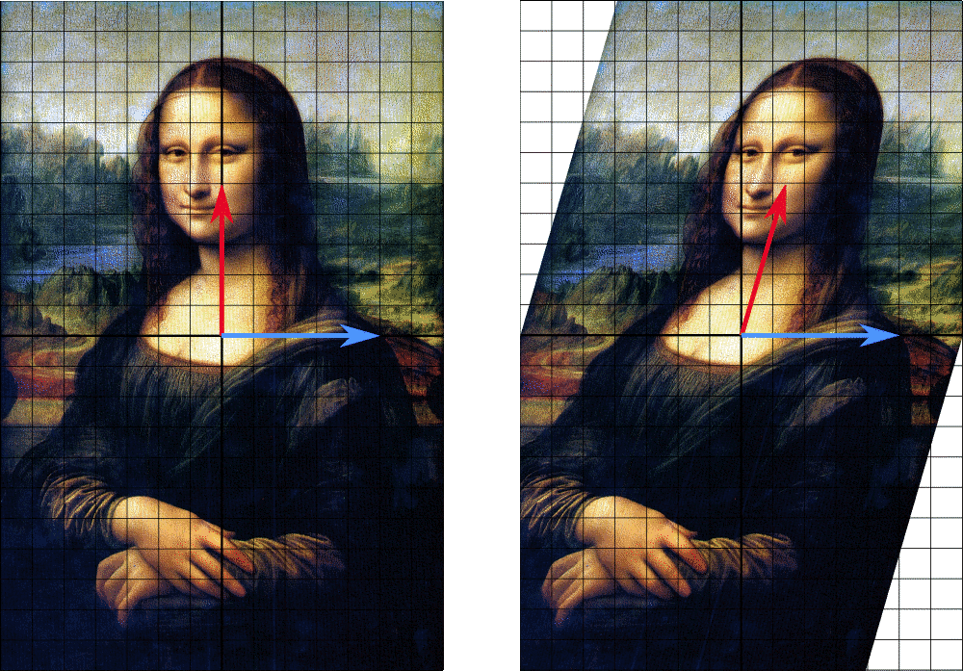
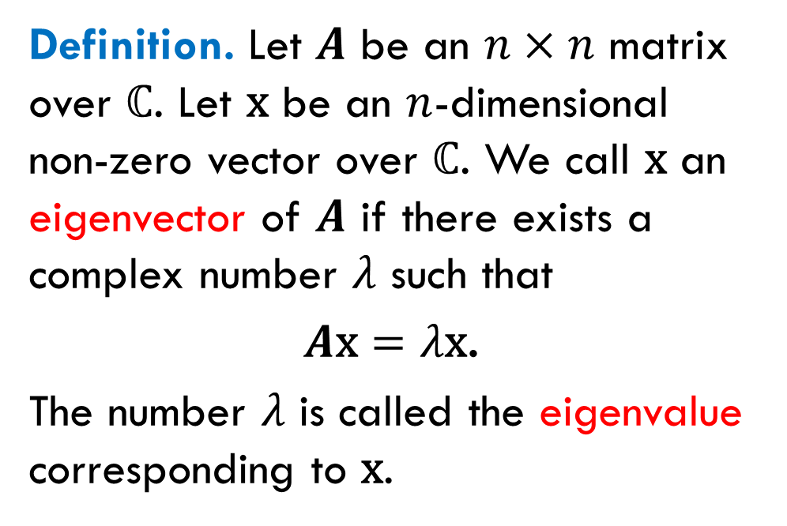
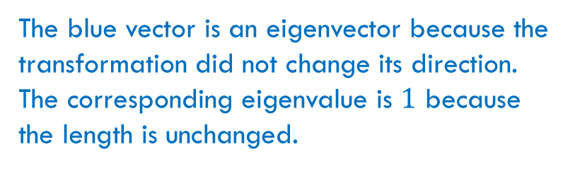
Eigenvectors and Eigenvalues
Definition. Let $A$ be an $n×n$ matrix over $ℂ$. Let $\text{x}$ be an $n$-dimensional non-zero vector over $ℂ$. We call $\text{x}$ an eigenvector of $A$ if there exists a complex number $λ$ such that
$A\text{x}=λ\text{x}$.
The number $λ$ is called the eigenvalue corresponding to $\text{x}$.
The blue vector is an eigenvector because the transformation did not change its direction. The corresponding eigenvalue is $1$ because the length is unchanged.

Slide 9
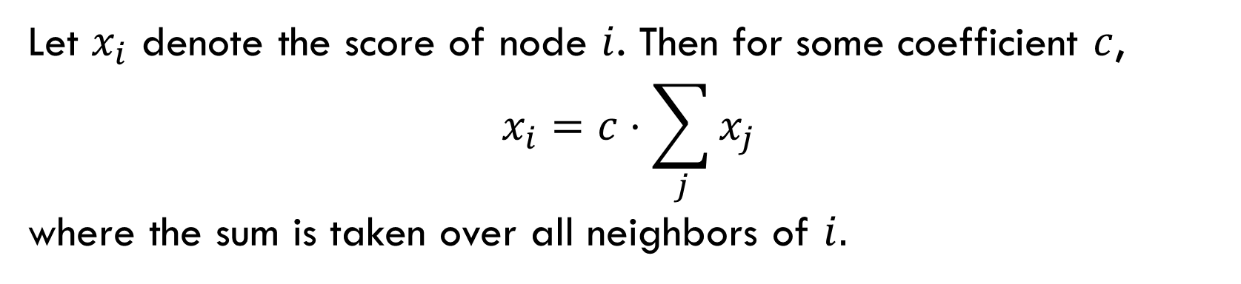
Idea of Eigenvector Centrality
Degree centrality: the score of a node is equal to the number of its neighbors.
Eigenvector centrality: the score of a node is proportional to the sum of the scores of its neighbors.
Let $x_{i}$ denote the score of node $i$. Then for some coefficient $c$,
$$x_{i}=c⋅\sum_{j}{x_{j}}$$
where the sum is taken over all neighbors of $i.$

Slide 10

Matrix Eigenequation
We have
$$x_{i}=c⋅\sum_{j}{x_{j}}=c⋅\sum_{j=1}^{n}{A_{ij}x_{j}}$$
or, in matrix form,
$$\text{x}=c⋅A\text{x}$$
which can be written as
$$A\text{x}=\frac{1}{c}\text{x}$$

Slide 11
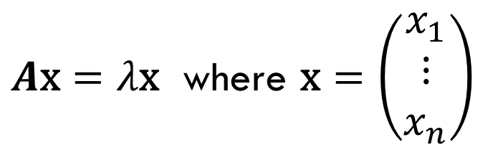
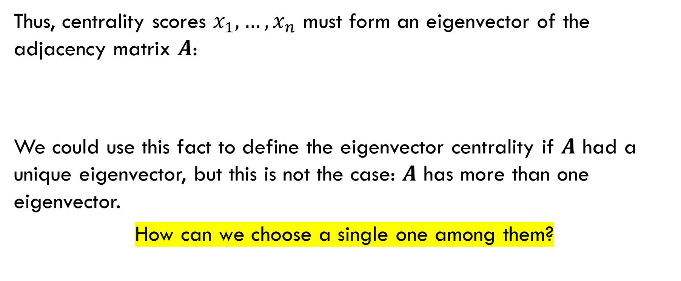
Question
Thus, centrality scores $x_{1},…,x_{n}$ must form an eigenvector of the adjacency matrix $A$:
We could use this fact to define the eigenvector centrality if $A$ had a unique eigenvector, but this is not the case: $A$ has more than one eigenvector.
How can we choose a single one among them?
$A\text{x}=λ\text{x}$ where $\text{x}=\left(\begin{matrix}x_{1} \\ ⋮ \\ x_{n}\end{matrix}\right)$

Slide 12
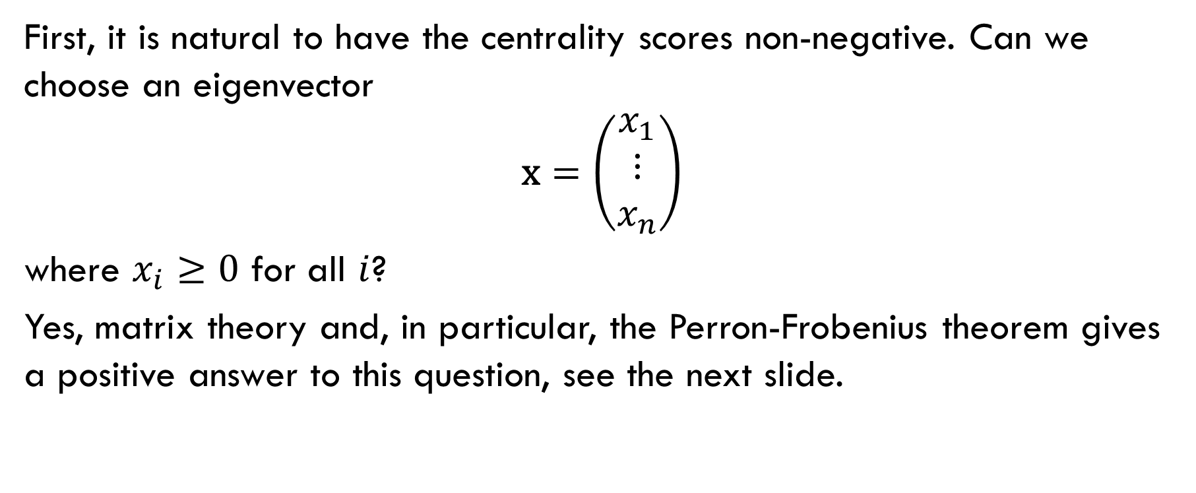
Non-Negative Centrality Scores
First, it is natural to have the centrality scores non-negative. Can we choose an eigenvector
$$\text{x}=\left(\begin{matrix}x_{1} \\ ⋮ \\ x_{n}\end{matrix}\right)$$
where $x_{i}≥0$ for all $i$?
Yes, matrix theory and, in particular, the Perron-Frobenius theorem gives a positive answer to this question, see the next slide.

Slide 13
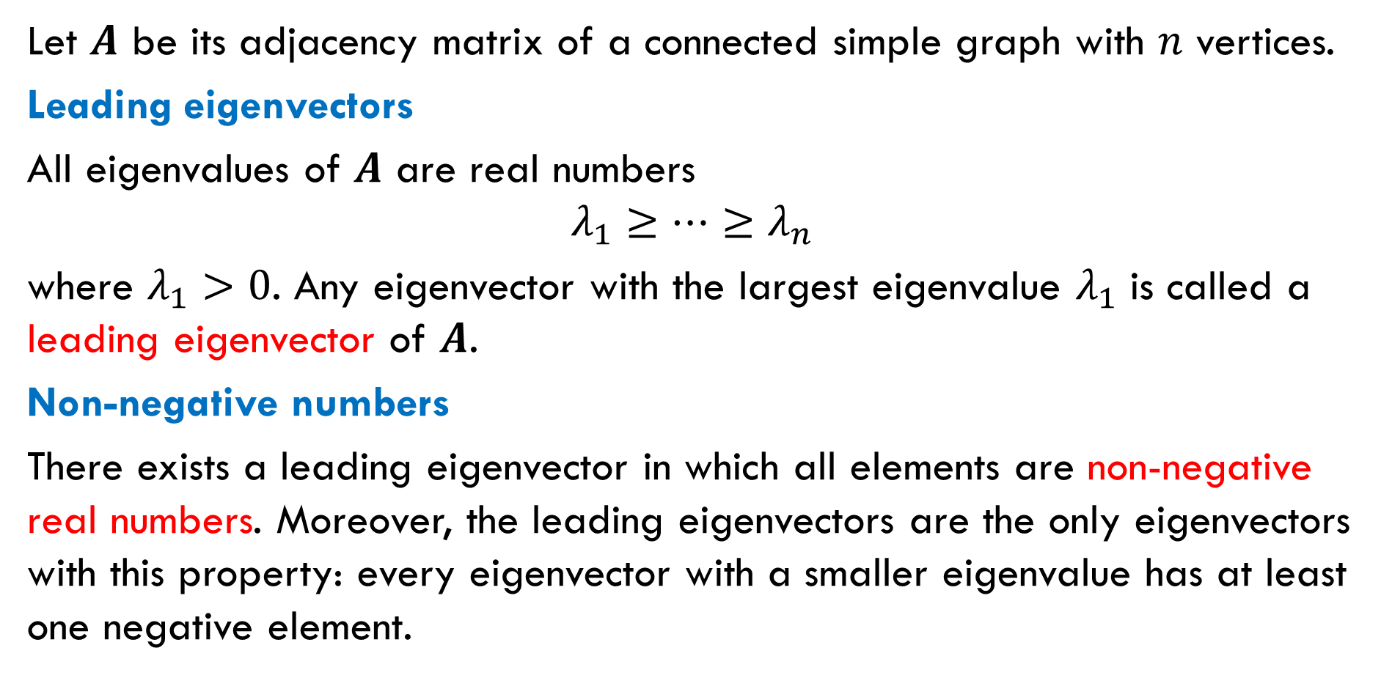
Let $A$ be its adjacency matrix of a connected simple graph with $n$ vertices.
Leading eigenvectors
All eigenvalues of $A$ are real numbers
$$λ_{1}≥…≥λ_{n}$$
where $λ_{1}>0$. Any eigenvector with the largest eigenvalue $λ_{1}$ is called a leading eigenvector of $A$.
Non-negative numbers
There exists a leading eigenvector in which all elements are non-negative real numbers. Moreover, the leading eigenvectors are the only eigenvectors with this property: every eigenvector with a smaller eigenvalue has at least one negative element.

Slide 14
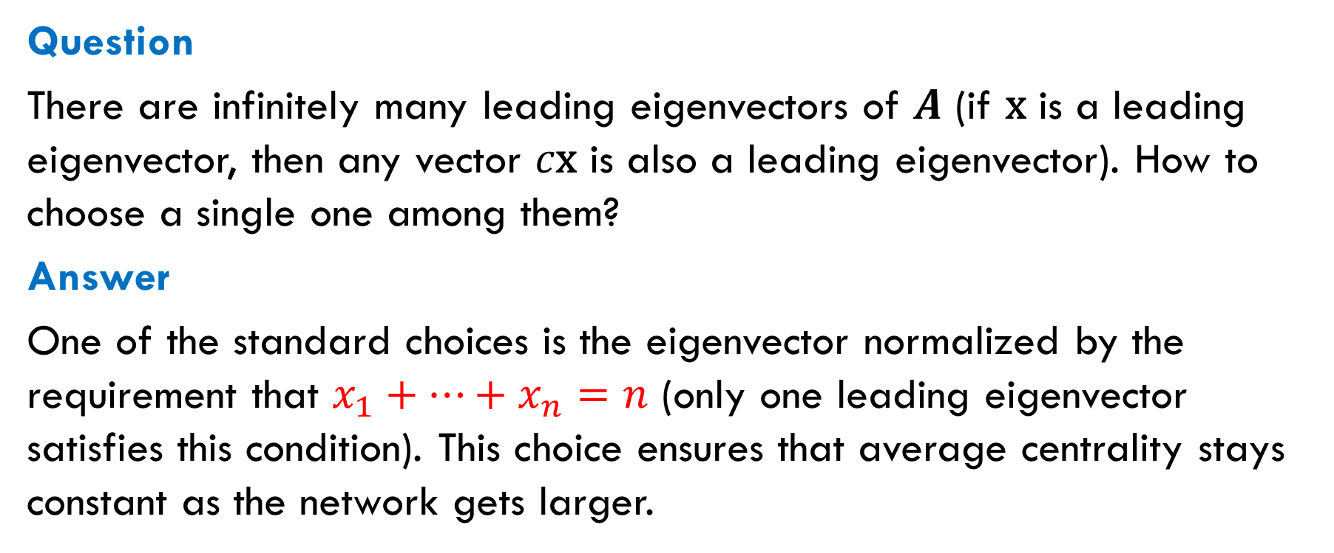
Choosing a Unique Eigenvector
Question
There are infinitely many leading eigenvectors of $A$ (if $\text{x}$ is a leading eigenvector, then any vector $c\text{x}$ is also a leading eigenvector). How to choose a single one among them?
Answer
One of the standard choices is the eigenvector normalized by the requirement that $x_{1}+…+x_{n}=n$ (only one leading eigenvector satisfies this condition). This choice ensures that average centrality stays constant as the network gets larger.

Slide 15
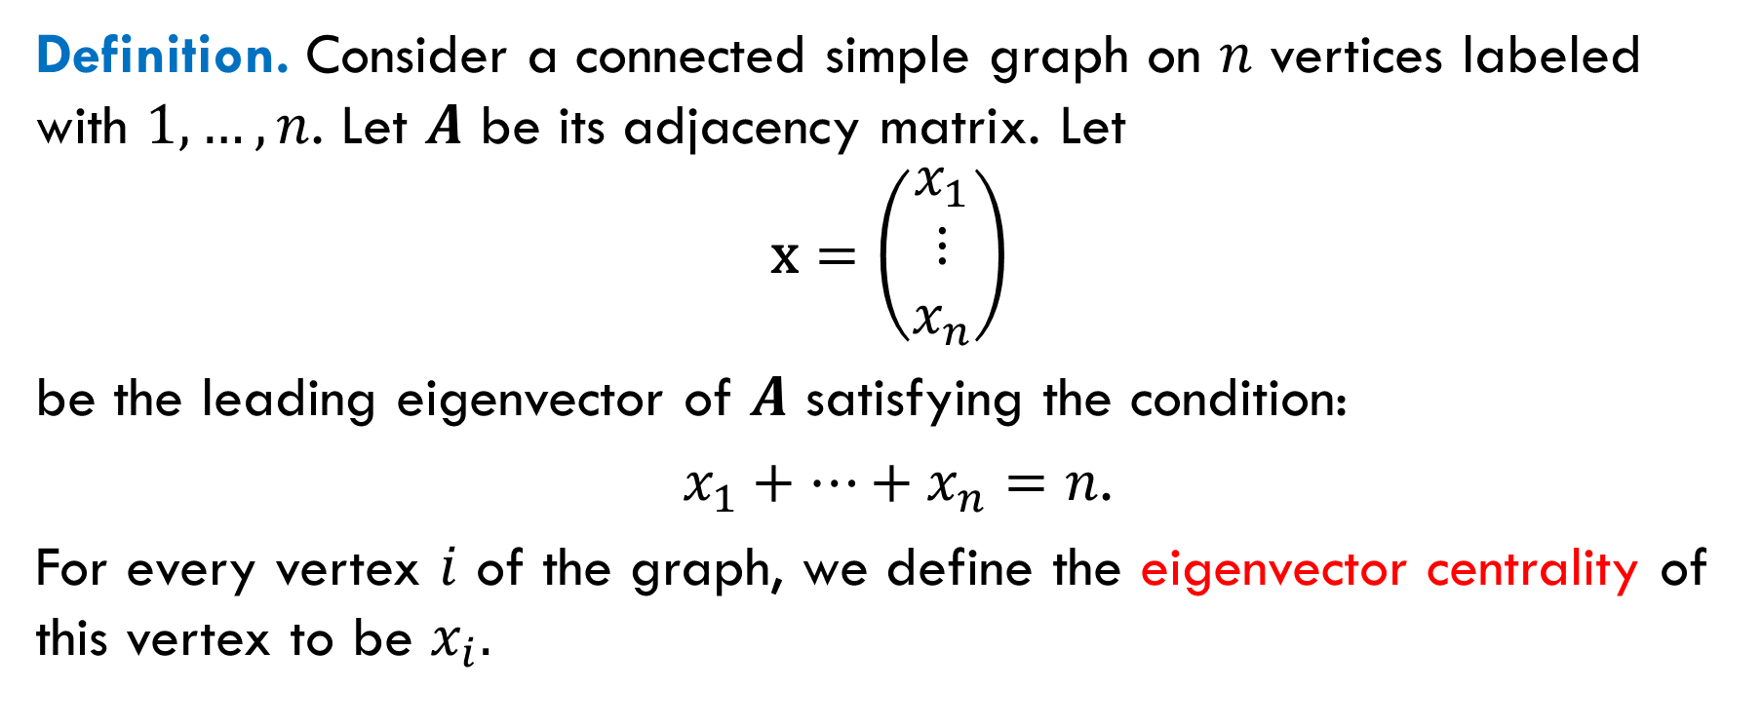
Definition of Eigenvector Centrality
Definition. Consider a connected simple graph on $n$ vertices labeled with $1,…,n$. Let $A$ be its adjacency matrix. Let
$$\text{x}=\left(\begin{matrix}x_{1} \\ ⋮ \\ x_{n}\end{matrix}\right)$$
be the leading eigenvector of $A$ satisfying the condition:
$x_{1}+…+x_{n}=n$.
For every vertex $i$ of the graph, we define the eigenvector centrality of this vertex to be $x_{i}.$

Slide 16
Computing Eigenvector Centrality

Slide 17
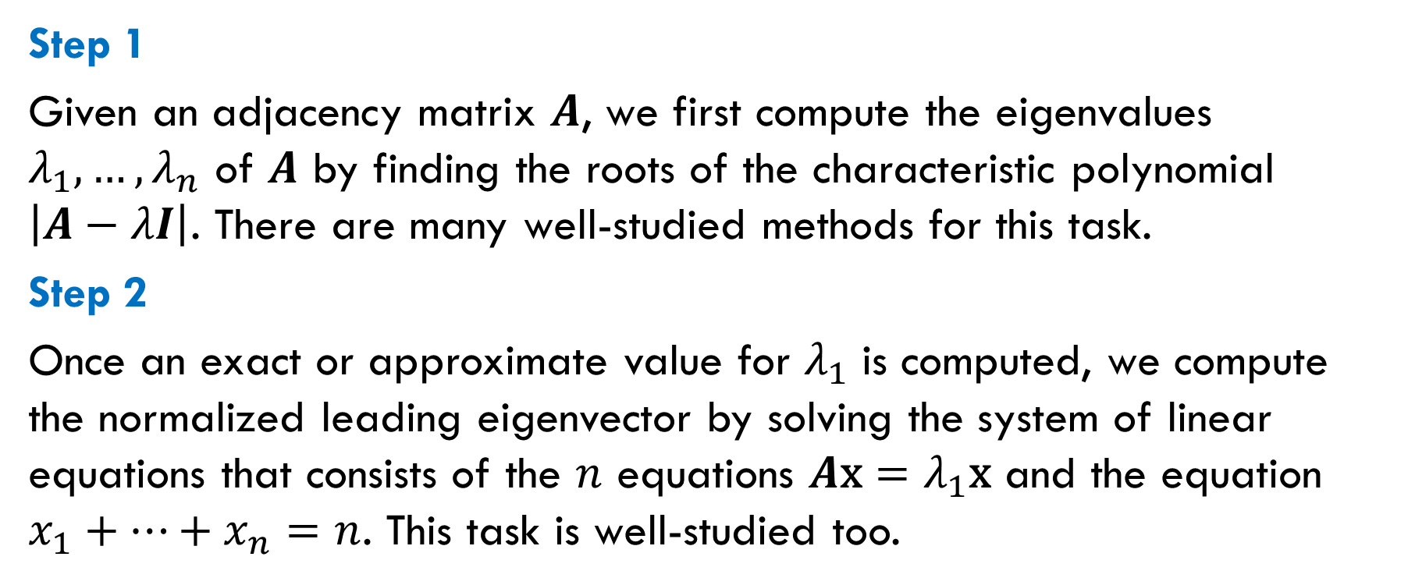
Classical Method
Step 1
Given an adjacency matrix $A$, we first compute the eigenvalues $λ_{1},…,λ_{n}$ of $A$ by finding the roots of the characteristic polynomial $\left|A−λI\right|$. There are many well-studied methods for this task.
Step 2
Once an exact or approximate value for $λ_{1}$ is computed, we compute the normalized leading eigenvector by solving the system of linear equations that consists of the $n$ equations $A\text{x}=λ_{1}\text{x}$ and the equation $x_{1}+…+x_{n}=n$. This task is well-studied too.

Slide 18
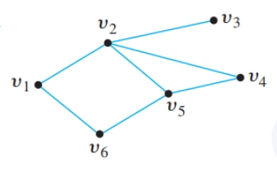
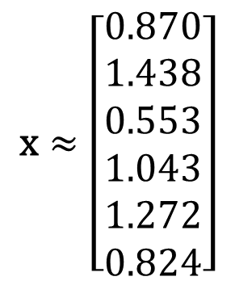
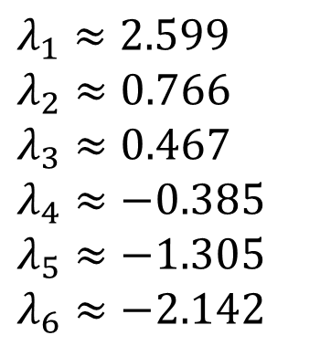
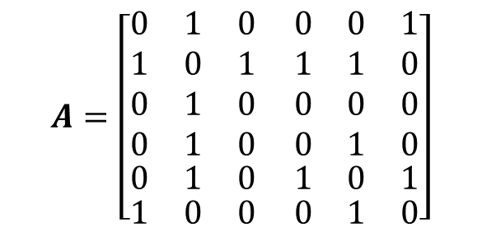
Example
$$A=\left[\begin{aligned}\begin{aligned}\begin{aligned}\begin{matrix}0 & 1 & 0\end{matrix} \begin{matrix}0 & 0 & 1\end{matrix} \\ \begin{matrix}1 & 0 & 1\end{matrix} \begin{matrix} 1 & 1 & 0\end{matrix} \\ \begin{matrix}0 & 1 & 0\end{matrix} \begin{matrix} 0 & 0 & 0\end{matrix} \\ \begin{matrix}0 & 1 & 0\end{matrix} \begin{matrix} 0 & 1 & 0\end{matrix}\end{aligned} \\ \begin{matrix}0 & 1 & 0\end{matrix} \begin{matrix} 1 & 0 & 1\end{matrix}\end{aligned} \\ \begin{matrix}1 & 0 & 0\end{matrix} \begin{matrix} 0 & 1 & 0\end{matrix}\end{aligned}\right]$$
To find the eigenvalues, we need to solve the equation $\left|A−λI\right|=0$.
$$λ_{1}≈2.599$$
$$λ_{2}≈0.766$$
$$λ_{3}≈0.467$$
$$λ_{4}≈−0.385$$
$$λ_{5}≈−1.305$$
$$λ_{6}≈−2.142$$
$$\text{x}≈\left[\begin{aligned}0.870 \\ 1.438 \\ 0.553 \\ 1.043 \\ 1.272 \\ 0.824\end{aligned}\right]$$
the normalized leading eigenvector;
its elements are the centrality scores
Notes:
One of many eigenvector calculators: https://matrixcalc.org/vectors.html

Slide 19
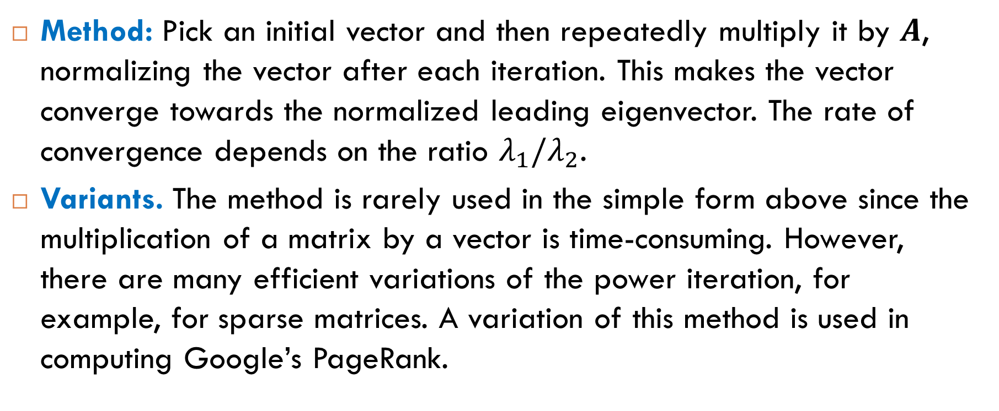
Power Iteration Method
Method: Pick an initial vector and then repeatedly multiply it by $A$, normalizing the vector after each iteration. This makes the vector converge towards the normalized leading eigenvector. The rate of convergence depends on the ratio $λ_{1}/λ_{2}$.
Variants. The method is rarely used in the simple form above since the multiplication of a matrix by a vector is time-consuming. However, there are many efficient variations of the power iteration, for example, for sparse matrices. A variation of this method is used in computing Google’s PageRank.

Slide 20
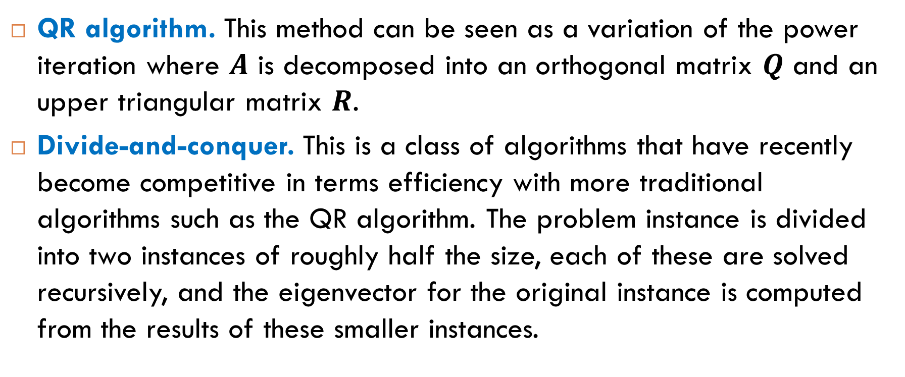
More Eigenvector Algorithms
QR algorithm. This method can be seen as a variation of the power iteration where $A$ is decomposed into an orthogonal matrix $Q$ and an upper triangular matrix $R$.
Divide-and-conquer. This is a class of algorithms that have recently become competitive in terms efficiency with more traditional algorithms such as the QR algorithm. The problem instance is divided into two instances of roughly half the size, each of these are solved recursively, and the eigenvector for the original instance is computed from the results of these smaller instances.

Slide 21
Extension to Directed Graphs

Slide 22
Complications
Many real-world networks are modeled by directed graphs, so we need to extend eigenvector centrality to directed graphs. However, many complications arise.
One source of complications is asymmetry of the adjacency matrix. It is more natural to measure centrality by taking into account incoming edges rather than outgoing edges. Typical examples are citations in scientific literature and hyperlinks on the Web.
Another reason for complications is a different type of connectivity, see examples in section 7.1.2 in Newman’s book.

Slide 23
Main Variants
The idea of eigenvector centrality can be adjusted to the case of directed graphs. The main variants are
Katz centrality (Newman’s book, section 7.1.3);
Google’s PageRank;
HITS ranking.
next topics
The method takes into account both incoming and outgoing edges.
The method takes into account only incoming edges.

Slide 24

Reading
Sections 7.1.1-7.1.2

